Slide 1
Azure Multi-Region
Secure Cloud Infrastructure
Notes:
Welcome slide for the Azure Multi-Region Secure Cloud Infrastructure architecture review. This presentation covers all aspects of the design including security, scalability, networking, and deployment flow across West US 2 and Central India regions.

Slide 2
Project Overview
Goals, Business Requirements & Architecture Philosophy
Multi-Region Resilience
Zero-Trust Security
Workloads span West US 2 (gateway) and Central India (app tier) to ensure geographic redundancy and serve users with low latency globally.
No VM has a public IP. All inbound traffic flows through WAF + App Gateway. Management access exclusively via Azure Bastion.
High Availability
Private Data Access
VM Scale Sets with ILBs ensure the application can absorb traffic spikes and survive individual VM failures without downtime.
Cosmos DB is accessed only through a Private Endpoint — the database is never exposed to the public internet under any condition.
Notes:
The architecture is designed around three pillars: Security (WAF, Bastion, NSG, Private Endpoints), Scalability (VMSS, ILBs, NAT Gateway), and Availability (multi-region, redundant paths). This is production-grade infrastructure suitable for enterprise SaaS applications.

Slide 3
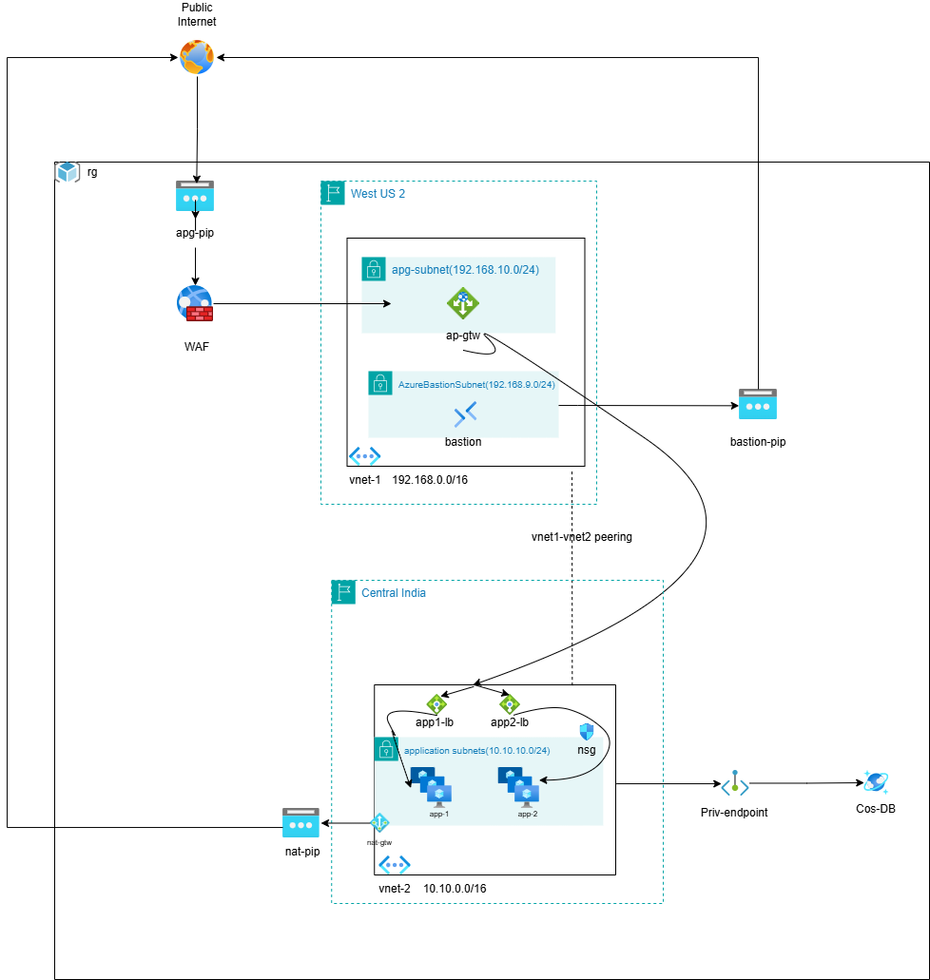
Notes:
Traffic from the internet enters via the Public IP (apg-pip), gets inspected by WAF, routed by Application Gateway, travels across VNet Peering to Central India, distributed by ILBs to App VMs, which then access Cosmos DB via a Private Endpoint. Administrators access VMs securely via Azure Bastion without any public IP on the VMs.

Slide 4
Traffic Flow Walkthrough
Step-by-step request lifecycle: User to Database
1
User → apg-pip
5
Internal Load Balancer
User browser sends HTTPS request to apg-pip (public IP). DNS resolves app domain to apg-pip.
app1-ilb or app2-ilb receives the request. Health-checked backend pool determines which VM instance handles it.
2
WAF Inspection
6
Application VM (VMSS)
WAF in Prevention mode inspects all HTTP headers, body, query params. Blocks malicious payloads (SQLi, XSS). Allowed traffic continues.
Selected VM processes the request. NSG has already filtered traffic at the subnet boundary.
3
App Gateway Routing
7
Cosmos DB via Private Endpoint
inspects URL path. /api/* → app1-ilb backend. /app/* → app2-ilb backend.
VM resolves Cosmos DB → private IP via Private DNS. Database query travels privately within Azure network.
4
VNet Peering Transit
Traffic crosses from vnet-1 (West US 2) to vnet-2 (Central India) via Global VNet Peering on Microsoft backbone.
🔐 Admin Access: Azure Portal → Bastion (bastion-pip, TLS 443) → VNet Peering → app-1 or app-2 VM (SSH on port 22, no public IP required)
Notes:
This is the complete request lifecycle. Steps 1-7 represent the happy path for an end user. The admin flow is entirely separate and uses Bastion for secure management access. Return traffic follows the reverse path. All DNS resolution is handled by Azure Private DNS Zones for the Private Endpoint.

Slide 5
Virtual Network Architecture
Dual-VNet design with subnet isolation strategy
vnet-1 · West US 2 · 192.168.0.0/16
vnet-2 · Central India · 10.10.0.0/16
apg-subnet
application subnet
192.168.10.0/24
10.10.10.0/24
Application Gateway
app1-lb (Internal Load Balancer)
app2-lb (Internal Load Balancer)
app-1 (VM / VMSS)
app-2 (VM / VMSS)
nat-gtw (NAT Gateway)
NSG (Network Security Group)
AzureBastionSubnet
192.168.9.0/24
Azure Bastion
Notes:
The dual-VNet design enforces strict segmentation. vnet-1 hosts only the ingress and management tier. vnet-2 hosts the application and data tier. Non-overlapping CIDR ranges (192.168.x.x vs 10.10.x.x) are mandatory for VNet Peering. The AzureBastionSubnet must use that exact name — Azure enforces this.

Slide 6
Application Gateway + WAF
Layer 7 intelligent routing with built-in web application firewall
Application Gateway (ap-gtw)
WAF (Web Application Firewall)
Why Not Expose VMs Directly?
Deployed in apg-subnet (192.168.10.0/24) with public IP apg-pip
Operates at OSI Layer 7 — understands HTTP/HTTPS, host headers, URL paths
Performs SSL/TLS termination — backend VMs never handle certificate complexity
Path-based routing and domain based routing
Health probes continuously test backend VM health — unhealthy VMs removed automatically
Integrated WAF operates in Prevention Mode in production
OWASP Core Rule Set 3.2 — blocks SQLi, XSS, CSRF, LFI, RFI attacks
WAF logs every blocked request to Log Analytics for forensic analysis
Bot protection rules filter malicious automated traffic
Without WAF, application servers would directly face internet attack traffic
Direct VM exposure = attack surface: every port is a potential entry point
App Gateway provides a single, hardened ingress point for all traffic
Backend VMs have NO public IPs — unreachable from internet directly
Notes:
The Application Gateway is the single entry point for all user traffic. Combined with WAF, it provides enterprise-grade L7 security. In interviews, emphasize that the App Gateway sits in its own dedicated subnet (apg-subnet) per Azure requirements, and that WAF in Prevention mode actively blocks rather than just logs threats.

Slide 7
Azure Bastion
Secure, browser-based VM management without public IPs
What is Azure Bastion?
Traditional (Risky) vs Bastion
❌ Traditional: VM has public IP → port 22 open → brute force attacks, credential stuffing
❌ Jump Box: Extra VM to manage, patch, secure — creates another attack surface
✅ Bastion: No public IP on VM, no open SSH/RDP ports, Azure AD auth + MFA, fully managed
Deployed inside AzureBastionSubnet (192.168.9.0/24) — subnet name is mandatory
Provides browser-based SSH (Linux) and RDP (Windows) to VMs via Azure Portal
bastion-pip is the PUBLIC IP of Bastion — NOT the VM. VMs have zero public IPs
Connection is established over TLS 443 — no need to open port 22 or 3389 in NSG
No client software required — works from any modern browser
Session recordings can be captured to Azure Blob Storage for compliance audits
Just-in-Time (JIT) VM access integration available for further hardening
Mandatory Subnet Rules
Subnet MUST be named 'AzureBastionSubnet' — Azure rejects any other name
Minimum /26 subnet size required (64 IPs) for Bastion scaling
NSG on Bastion subnet must allow inbound TCP 443 from Internet
NSG must allow outbound TCP 3389, 22 to VirtualNetwork
Notes:
Azure Bastion is a critical security component. In this architecture, app-1 and app-2 VMs have no public IPs — Bastion is the ONLY way to access them. This eliminates the most common attack vector (exposed SSH/RDP). The bastion-pip is shown in the diagram connected to the Bastion resource — this is Bastion's own management IP, not the VM's.

Slide 8
VNet Peering: vnet1-vnet2
Private Microsoft backbone connectivity between regions
How Peering Works
vnet-1 (West US 2) ↔ vnet-2 (Central India) connected via Global VNet Peering
Traffic stays entirely on Microsoft's private backbone — never touches public internet
Non-overlapping CIDRs required: 192.168.0.0/16 and 10.10.0.0/16
Peering is bi-directional: two peering links created (vnet1→vnet2 and vnet2→vnet1)
Traffic Flow via Peering
User request → apg-pip (West US 2) → App Gateway → [VNet Peering] → ILB in Central India → App VM
Return path: App VM → ILB → [VNet Peering] → App Gateway → apg-pip → User
Admin: Bastion (West US 2) → [VNet Peering] → App VM SSH session (Central India)
All cross-region traffic is private, low-latency, and encrypted at the Microsoft network layer
Notes:
Global VNet Peering is the backbone of this multi-region architecture. Without it, App Gateway couldn't reach the application VMs in a different region. The peering is configured with 'Allow forwarded traffic' and 'Allow gateway transit' disabled since both VNets use peering directly.

Slide 9
Internal Load Balancers (app1-ilb, app2-ilb)
Private traffic distribution within the application subnet
Standard Internal Load Balancer with private frontend IP in 10.10.10.0/24
Distributes traffic from App Gateway to VMSS backend pool
Health probes on TCP:80 — removes unhealthy VMs from rotation in < 30 sec
No public IP — only reachable from within the VNet or peered VNets
Enables zero-downtime rolling deployments: drain one VM, update, re-add
Each ILB has independent health probes, backend pools, and load balancing rules
Supports TCP/UDP load balancing for non-HTTP application protocols
Notes:
Internal Load Balancers are private by design — they only have a private frontend IP. App Gateway (in vnet-1) reaches the ILBs via VNet Peering. The two-ILB design allows independent scaling and updating of app1 and app2 workloads. In production, the ILBs are typically zone-redundant (spanning AZs 1, 2, 3).

Slide 10
VM Scale Sets (VMSS) — app-1 & app-2
Auto-scaling application hosting behind internal load balancers
VMSS Core Benefits
Deployment Architecture
HA & Fault Tolerance
Auto-scale based on CPU, Memory, HTTP queue depth, or custom metrics
Scale OUT: add VMs when load increases (e.g., CPU > 70% for 5 min)
Scale IN: remove VMs when load drops (e.g., CPU < 30% for 10 min)
VMs distributed across Fault Domains — hardware failure doesn't take down all VMs
Identical VM configuration across all instances — no snowflake servers
All VMSS VMs in application subnet (10.10.10.0/24)
VMs launched from golden image or marketplace image with cloud-init
Application deployed via custom script extension or Azure DevOps pipeline
VMs pull updates from Azure Storage or private container registry
NAT Gateway provides outbound internet for package downloads / API calls
Availability Zones: VMs spread across Zone 1, 2, 3 in Central India
If one AZ goes down, other AZs still serve traffic
Health extension on VMSS detects unhealthy app state → replaces VM automatically
Overprovision setting: VMSS creates extra VMs during scale-out for faster response
Integration with Azure Monitor for predictive auto-scaling
Scale set capacity can be managed via Azure Autoscale profiles (schedule + metric)
Notes:
VMSS is the backbone of the compute tier. In this architecture, app-1 and app-2 represent two different application workloads (could be microservices). They share the same subnet but are isolated via separate ILBs and NSG rules. The auto-scaling ensures the infrastructure handles traffic spikes without manual intervention.

Slide 11
NAT Gateway (nat-gtw)
Controlled outbound internet access with static IP
Why NAT Gateway?
Security Advantage
App VMs have NO public IPs — they cannot directly initiate outbound internet connections
VMs need outbound access for: package manager updates, license validation, external API calls, telemetry
NAT Gateway provides SNAT (Source Network Address Translation) using nat-pip (static public IP)
All outbound connections from the application subnet flow through nat-gtw → nat-pip
External services (APIs, SaaS, CDNs) always see traffic from a single, known IP
Inbound connections through NAT Gateway are BLOCKED by default — only outbound SNAT
Cannot be used to reach VMs from internet — App Gateway + ILB are the only inbound paths
Notes:
NAT Gateway is attached to the application subnet in vnet-2. It uses nat-pip as the static outbound IP. In production, organizations often attach 2-3 public IPs to a NAT Gateway to increase available SNAT ports (64K ports × number of IPs). The NAT Gateway is a fully managed, zone-redundant service.

Slide 12
Private Endpoint + Azure Cosmos DB
Private database connectivity with globally distributed NoSQL
Private Endpoint (Priv-endpoint)
Azure Cosmos DB (Cos-DB)
A Private Endpoint creates a Network Interface Card (NIC) inside the application subnet
This NIC gets a private IP from 10.10.10.0/24 — Cosmos DB gets a private address
App VMs resolve Cosmos DB hostname → private IP (not public Cosmos endpoint)
Azure Private DNS Zone: privatelink.documents.azure.com resolves to private IP
All database traffic stays within the VNet — never leaves Microsoft network
Cosmos DB public endpoint can be DISABLED entirely after Private Endpoint setup
Even if Cosmos DB credentials were stolen, attacker cannot reach DB from internet
Multi-model NoSQL database: SQL API, Mongo API, Cassandra API, Gremlin API
Globally distributed: replicate data to any Azure region with one click
Automatic indexing — no index management required
Notes:
The Private Endpoint is one of the most important security features in this architecture. Without it, Cosmos DB would need to rely solely on RBAC and IP firewall rules. With it, the database is completely network-isolated. The Private DNS Zone must be linked to vnet-2 for VMs to resolve the private IP correctly.

Slide 13
Security Architecture
Defense-in-depth: 5 layers of protection
1
WAF — L7 Attack Prevention
OWASP rules block SQLi, XSS, CSRF before traffic reaches any compute resource. First line of defense.
2
App Gateway — Ingress Control
Single, hardened ingress point. SSL termination, path routing, health probing. Backend VMs invisible to internet.
3
NSG — Subnet Micro-Segmentation
Default-deny L4 firewall. Only whitelisted IPs and ports can communicate between subnets.
4
Bastion — Zero-Trust Management
No public IPs on any VM. Admin access exclusively via Azure AD-authenticated browser sessions.
5
Private Endpoint — Data Isolation
Cosmos DB unreachable from public internet. All DB traffic on private Microsoft network.
Notes:
This architecture implements defense-in-depth — even if one security control is bypassed, additional layers stop the attack. No single point of failure in the security model. In a penetration test, an attacker would need to: bypass WAF, compromise App Gateway, defeat NSG rules, and still cannot reach the database without being inside the VNet.

Slide 14
Architecture Summary
Azure Multi-Region Secure Cloud Infrastructure
Secure
Scalable
Highly Available
Cloud-Native
WAF · Bastion · NSG · Private Endpoint · Zero Public IPs on VMs
VMSS Auto-Scale · App Gateway v2 · Cosmos DB
Zone-Redundant · Multi-Region · Auto-Heal
Managed Services · IaC-Ready · Azure Well-Architected
2
2
5+
∞
Azure Regions
VNets / Subnets
Security Layers
Auto-Scale Range
Designed · Deployed · Documented by Cloud/DevOps Engineering
Notes:
This architecture demonstrates production-grade Azure infrastructure combining multi-region deployment, defense-in-depth security, and elastic scalability. All design decisions are driven by real-world enterprise requirements. The architecture can be deployed end-to-end using Terraform in under 30 minutes.

